Slide 1


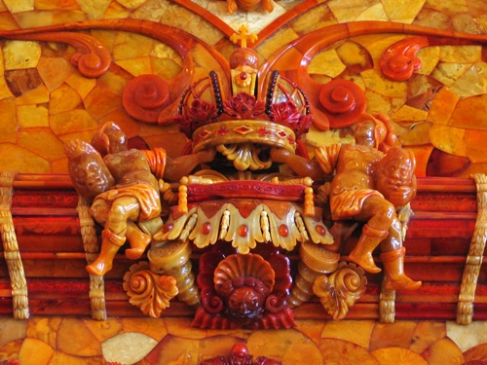
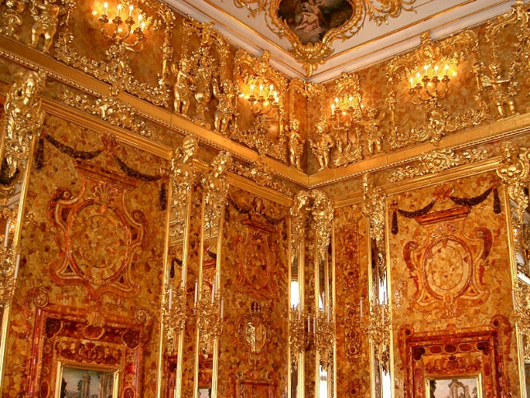
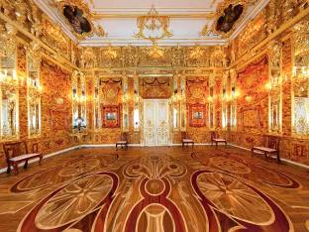
Cultural relics
Language points

Slide 2

couldn't + have + done 表示对过去事情的否定推测，译成“不可能做过某事”
4
同位语
1.Frederick William I, , could never have imagined
the King of Prussia
that his greatest gift to the Russian people would have such an amazing history.
宾语从句
普鲁士国王威廉一世绝不可能想到他送给俄罗斯人民的厚礼会有这样一段令人惊讶的历史。
We couldn't have done it without you.
没有你我们肯定完成不了。
The road isn't wet. It couldn't have rained last night.
路面没有湿，昨晚不可能下雨。

Slide 3

2. However, the next King of Prussia, Frederick William I, to whom the amber room belonged, decided not to keep it.
主语同位语
whom引导的非限制性定语从句
当先行词在定语从句中充当介词宾语时，可使用介词+which/whom的结构引导从句。
然而，下一位普鲁士国王，腓特烈▪ 威廉一世, 这个琥珀屋的主人却决定不要它了。

Slide 4

Translation
1. People here, men and women, old and young, supported the project.
这儿的男女老少都支持这项工程。
2. 我最好的朋友，也就是安娜，昨天晚上和我在一起。
My best friend, (that is to say) Anna, was here with me last night.
3. 我碰见了个过去曾一起工作的人。
I met a man with whom I used to work.

Slide 5
3. Later, Catherine II had the Amber Room moved to a palace outside St Petersburg where she spent her summers.
定语从句
后来，叶卡捷琳娜二世派人把琥珀屋搬到圣彼得堡郊外她避暑的宫殿中。
have sth. done
让/使别人做某事
I had my watch repaired yesterday.
昨天我让人修了手表。
She might just have her hair waved.
她可能刚刚烫了发。

Slide 6

Translation
1. 她正在检测眼睛。
She is having her eyes tested.
2. 他将会叫人修理这台旧机器。
He is going to have this old machine repaired.

Slide 7





Slide 8
QuizⅠ: Fill in the blanks according to the information given in the brackets.
amazing
1. It's ________ (surprising) to think that
the managing director is only 23.
2. There was a choice of four prizes, and
the winner could _____ (choose) one of
them.
3. He ________ (设计) and built his own
house.
4. She didn't _____ (= did not like) the idea
of going home in the dark.
select
designed
fancy

Slide 9
5. She does everything with _____ (风度)
and grace.
6. Monet is one of my favourite ______.
7. Where do these plates ______ (= where
are they kept)?
8. The President gave a ________ (招待会)
for the visiting heads of state.
9. The men came to _______ (搬开) the
rubbish from the backyard.
10. I ______ (怀疑) whether/if I can catch a
fish before dinner.
style
artists
belong
reception
remove
doubt

Slide 10
Quiz Ⅱ: Translation.
1. 43年前录制这首歌的时候，卡特可能
绝对没有想到这首歌能够在这么多年
后赢得2万美元的版税和6项格莱美大
奖。
On that day 43 years ago, Carter ____________________________ the song would lead to a $20,000 royalty check and six Grammy awards.
could never have imagined that

Slide 11
2. 这些房子是为老年人设计的。
The houses ______________ old people.
are designed for
3. 我送给他一份礼物以回报他的帮助。
in return for
I sent him a present ___________ his help.
4. 第二次世界大战期间，德国几乎同世
界上所有的国家处于交战状态。
During the Second World War, Germany __________ with almost all the countries in the world.
was at war

